Slide 1
STAT3013 Project: Childhood Brain Cancer in Florida: A Bayesian Clustering Approach¹
Mikkel Mertz, James Bailie, and Anthony Cozens

Slide 2
The Scientific Question
To check the robustness of the findings of another publication² that there exists “putative clusters of paediatric brain cancer at zip code aggregation level in the U.S. state of Florida”.
In particular, the paper aims to confirm or refute that there is “the raised incidence of paediatric brain cancer was found in the southern area of the state (south Florida cluster)”.
Notes:
The aim of this project is to investigate spatial clusters of relative risk of the Florida childhood cancer.
A previous paper found clusters of paediatric brain cancer at the zip code level in Florida. The authors of our paper have modelled brain cancer incidence in new ways. They want to check if their models give similar results to the previous paper.
This paper fulfils “a perceived need for further analysis to assess the robustness of the findings under different assumptions”.
The paper is quite narrow in its question. It does not attempt to understand the clustering, or explain why there are clusters. It simply tries to determine whether any clusters actually exist.

Slide 3
The Data
The data was collected by the Florida Association of Paediatric Tumour Programs.
It consists of the incidence of recorded paediatric brain cancer in the years 2000-2010 in each zip code in Florida.
Included in the dataset is the population of 0-19 year olds in each zip code.
There are a 983 zip code areas, with 451 areas with zero cases recorded.
Notes:
There was no details in the paper about how the data was collected.
The data is not available online, not released for the general public. Interestingly, the paper is not very specific about the actual structure of the data. We assume, based on what they have modelled, that the data is simply a table of counts of the paediatric brain cancers and the at-risk population in each zip code area of Florida.
Interesting that the authors do not include any possible covariates – for example socio-economic, environmental factors.
You can see that the large number of zip code areas with zero cases may pose a problem. In particular, Poisson models generally have a problem modelling large numbers of zero-counts. But large numbers of zero-counts are common in incidences of rare diseases, like paediatric brain cancer.
They didn’t provide any visualisations of the data.

Slide 4

Assumptions
The statisticians assumed that the case counts follow a Poisson distribution:
y_{i}∼ Poisson(μ_{i} ), and μ_{i} =e_{i}θ_{i}, where
y_{i} - number of cases within the ith area,
e_{i} - number of expected cases in the ith area,
θ_{i} - relative risk parameter for the ith area,
y_{i}^{p} - population of the ith area during the time period.
Notes:
Type of clustering is non-focused, where they assume no previous knowledge of clusters, and prefer a flexible, lowly parameterized model. Allows the data “to speak”. This helps to answer the scientific question of whether there are clusters, since we assume very little to begin with. Consequently, finding clusters in the models would be strong evidence for actual clusters.
2 different natures of clustering, hot spots and clusters. Talk about the definitions and differences between hot spots and clusters.
(The sums in ei are over all of the zip code areas)
The statisticians uses 3 different models to model the θ_{i}’s and test the models measure of fit using various measures.
The models:
1. The Standardised morbidity ratio (SMR)
2. The Besag, York, and Mollie model (BYM)
3. The Sparse Poisson Convolution model (SPC)
The idea is to create these three models, then looks for clusters that are identified in all of these models. This would provide strong evidence for the scientific question. Each model is a natural extension of the previous model.

Slide 5
The Standardised Morbidity Ratio
Assume case counts are independent.
The SMR_{i} is the MLE of θ_{i}.
This model is most well-known and easiest to compute.
Problem: misleading when applied to rare diseases.
Notes:
This model assumes the case counts y_{i} are independently distributed then estimates θ_{i} using MLE.
This model estimates the relative risk factor θ_{i} as the actual counts y_{i} over the expected counts e_{i}. That is, the ratio between the observed and expected number of counts. This is the MLE for θ_{i}
Simplest of the models, but doesn’t work with the large number of zero counts in the data.
There is a large number of zero counts in the data. This can lead to the SMR being misleading, and can lead to large SMR’s regardless of the observed count.
This model proved to contain a lot of confounding noise.
It can, however, be used to obtain an explanatory view of how clusters distribute over the study area. It is basically a good way to initially visualise the data.

Slide 6
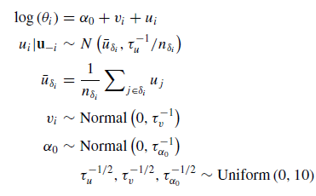
The Besag, York and Mollie Model
Notes:
For rare diseases in small areas, it can be difficult to estimate the relative risk factor θ_{i}. In this case, it is useful to borrow information from neighbouring areas. This is what the Besag, York and Mollie model attempts to do.
This is a hierarchical/multilevel model – the main formula is the log of relative risk. The regression coefficients are themselves given a model, whose parameters are also estimated from data.
This is a Bayesian model. Neighbourhood information is included as a random effect.
“The model decomposes the log of area-level relative risks into the sum of two random effects: one which is unstructured (heterogeneous), v_{i} , and the other spatially structured (dependent), u_{i}.”
“The spatially structured effects are modelled by the intrinsic conditional autoregressive normal (ICAR) prior distribution.”
“In simple formulation, the prior distribution can be specified as the conditional distribution of each area-specific spatially structured effect, given all other spatial effects, and is a normal distribution with mean equal to the average of its neighbours, and precision proportional to the number of these neighbours.”
“The neighbourhood set for the ith area is δ_{i} and the number of neighbours is n_{δi}.”
“This model has been shown in many studies to yield robust estimates across of range of scenarios, including clustering of disease”
The BYM model is a Bayesian approach to fitting θ_{i}. The model decomposes the log of θ_{i} into the sum of two random effects: v_{i}, which is the unstructured component, and u_{i}, which is the spatially structured component, which is dependent on the values of its neighbouring zip codes.
Main terms have a Gaussian prior distribution. Their precisions are taken from uniform(0,10) distribution.

Slide 7
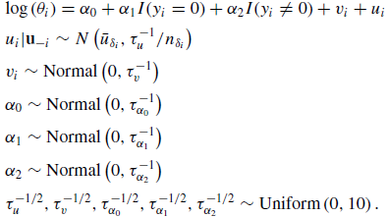
The SPC Model
Notes:
This is an extension of the BYM model. Again, Bayesian and hierarchical.
“Since childhood cancer is a rare disease, there are zip code areas with no cases. This sparseness of the count outcomes can be a problem as the Poisson data level model might not be able to model the situation where there can be multimodality in the marginal count distribution.”
They did consider using a zero-inflated Poisson (ZIP) model, but they decided to go for the simpler approach of having the zero counts have a different intercept.
They used the OpenBUGS software to generate their models. No code was provided with the article. They used Monte-Carlo Markov Chain sampling, with a sample size of 10 000 and a burn-in period of 10 000 iterations. The Brooks-Gelman-Rubin diagnostic (Brooks and Gelman 1998) was used to check convergence. This was also done in the BYM model case.
The SPC model is the BYM model with an indicator variable added in for whether the data value is zero or not. They have included this in the model, as zero counts in the data can be a problem since they are modelling it with a poisson distribution.

Slide 8
Model Checking
The statisticians use several methods to evaluate the models goodness-of-fit.
The deviance information criterion (DIC) is:
The exceedance probability (with threshold c) is:
is the average deviance over the sample
Notes:
The model checking procedures in the article are more about model comparing, as there are no cut-offs mentioned in the results or model evaluation sections, and in the results they only compare the structure of the results or compare the two different models values. They do not do any formal hypothesis tests or confidence intervals.
With these different model checking and comparing procedures, the lower value produced, the better the model is.
“A measure of goodness-of-fit that is widely used in Bayesian modelling is the deviance information criterion (DIC)”. It balances the number of parameters in the model with the explanatory power of the model. More parameters is worse, but more explanatory power is better. There is always a trade-off between the two. DIC quantifies this. pD is the effective number of parameters. D(θ^{g}) is the deviance of the gth sample parameter value.
Here θ^{g} is the sample parameter value of the gth sample.
The exceedance probability is used to find clusters, or hot spots in the relative risk of brain cancer.
The deviance information criterion is an overall goodness of fit test. To investigate localised behaviour they used an exceedance probability. To measure the predictive capability of the models they used the mean square predictive error. WAIC is an alternative to the DIC, and improves on some of the problems that it has, like that DIC is not fully Bayesian.
G is the sampler sample size (in the MCMC), in this article 10000.
The exceedence probability is calculated from the posterior sample values. It is calculated as how often (during the MCMC process) the relative risk exceeds a threshold. Used to evaluate how unusual the risk is in an area.
Larger values of c represent more extreme risk levels – usually c is set at 1, 2 or 3. You can then set a threshold, e.g. of 0.95, 0.975 or 0.99, above which an area would be identified as having unusual risk. This statistic investigates the localised behaviour of a model, as opposed to the DIC, which is an overall metric to assess how well a model fits the data generally.

Slide 9
Model Checking
The mean square predictive error (MSPE) is:
The Watanbe-Akaike information criterion (WAIC) is:
Notes:
Ways of examining overall goodness-of-fit.
Explain the MSPE: overall crude measure of loss across the data. To measure the predictive capability of a model, they used the mean squared predictive error, which compares the observed data to the predicted data from the fitted model.
It is the sum of the squared difference between the observed and predicted counts, divided by the sampler size and the number of data points. The second summation j is over each sample in the posterior samples.
Explain the WAIC: estimating the out-of-sample expectation – uses the log pointwise posterior predictive density. pWAIC is the bias adjustment. It is the sum (over the areas) of the variance of individual terms in the log density.
G is the sampler sample size.
m is the number of observations.
y^{pred}_{i} is the ith predictive data item.

Slide 10
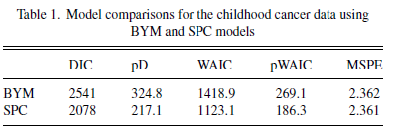
Results
When they compared the BYM and SPC models, they found that the SPC is a better fit to the data, but is only marginally better at predicting future data.
They also compared the SMR with the BYM and SPC models, and found that the BYM and SPC produced smoother risk estimates.
Notes:
They didn’t do all of the extra tests for the SMR model – they basically just used that model as a baseline to compare the BYM and SPC models to. BYM produces a smoother pattern of risks than the SPC model.
The SPC model has the lower DIC, WAIC and MSPE. It is better than the BYM model by a decent amount, besides the MSPE, in which there are basically the same. This is evidence that the SPC model fits the data better.
Only marginally better at predicting future data – according to the MSPE.
The overall variation of risk is similar in the three models. Smoother risk estimates - smoother pattern - i.e. not as large jumps between relative risk factors of neighbours.
We don’t have time to talk about the exceedence probabilities.

Slide 11
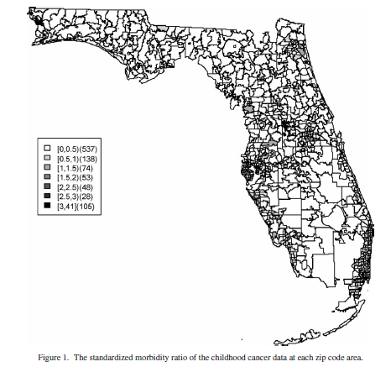
Results
Notes:
Apparently, according to the authors, you can see clustering, but the maps they provided are not particularly good.
These maps show the different models values of the relative risk of cancer in each of the zip code areas.
“In the SMR map, we can see aggregated risks in the middle of the state and some apparent hot spots scattered over the northeast and along the coasts”
In the BYM map we can still see the cluster in the north east and a clustering in the middle of the state and more hotspots along the coastal areas and north and also quite a few more with a relative risk of greater than one.
In the SPC map – basically the same as the BYM map – we can still see the cluster in the north east and a clustering in the middle of the state and more hotspots along the coastal areas and north and also quite a few more with a relative risk of greater than one, quite a few more than the BYM map.

Slide 12
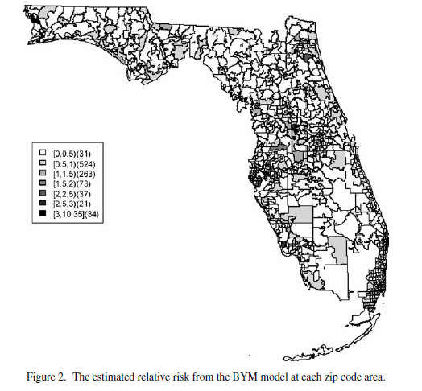
Results
Notes:
These maps show the different models values of the relative risk of cancer in each of the zip code areas.
“In the SMR map, we can see aggregated risks in the middle of the state and some apparent hot spots scattered over the northeast and along the coasts”
In the BYM map we can still see the cluster in the north east and a clustering in the middle of the state and more hotspots along the coastal areas and north and also quite a few more with a relative risk of greater than one.
In the SPC map – basically the same as the BYM map – we can still see the cluster in the north east and a clustering in the middle of the state and more hotspots along the coastal areas and north and also quite a few more with a relative risk of greater than one, quite a few more than the BYM map.

Slide 13
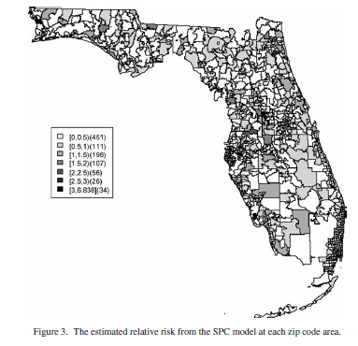
Results
Notes:
These maps show the different models values of the relative risk of cancer in each of the zip code areas.
“In the SMR map, we can see aggregated risks in the middle of the state and some apparent hot spots scattered over the northeast and along the coasts”
In the BYM map we can still see the cluster in the north east and a clustering in the middle of the state and more hotspots along the coastal areas and north and also quite a few more with a relative risk of greater than one.
In the SPC map – basically the same as the BYM map – we can still see the cluster in the north east and a clustering in the middle of the state and more hotspots along the coastal areas and north and also quite a few more with a relative risk of greater than one, quite a few more than the BYM map.

Slide 14
Extension – Immunisation Rates in Australia
Are there clustering of high unimmunised children in Australia?
Vaccination rates need to continue to improve to reach the 95% coverage goal for herd immunity³.
Outbreaks of measles linked to low vaccination rates⁴.
Notes:
Paper did not provide the data or code.
As our extension, we looked at immunisation rates of children in Australia at the postcode level. We wanted to know if there was evidence of spatial clustering of high unimmunised children.
Why is this important?
We need to continue to improve vaccination rates in Australia to reach the 95% coverage goal. The 95% level is touted as providing herd immunity which is important to prevent the spread of disease and protect at risk groups that are not able to be immunised.
In fact, there is some evidence that vaccination rates are decreasing in some areas with some serious consequences. There were outbreaks of measles cases in 2011 in Sydney high schools that have populations with low vaccination coverage. Measles cases have been increasing in Australia during the last decade.
These and future outbreaks could be prevented by targeted education in areas of low vaccination coverage. Understand clustering will allow organisations to allocate funding effectively and target under-immunised areas. Looking at overall coverage of vaccination can be misleading and dangerous - it is important to know whether there are some communities where levels are low enough to increase the risk that some contagious diseases may spread.

Slide 15
Extension - Data
Counts of immunised and non-immunised 1 year old children at the postcode level in 2014-2015⁵.
Binomially distributed.
ABS Postal Areas Shapefile⁶.
Notes:
Talk about the fact we couldn’t get cancer data by post code. We checked Australian cancer database, American states’ cancer databases. Or any data of rare diseases by post code freely online. Because of privacy/confidentiality/ethics/identifiability reasons. We would have had to formally request and sometimes pay for the data, which we didn’t want to do. We found data by primary health care networks and medicare locals, but there are too few of them and too big to be able to see much clustering.
As an indicator of general immunisation rates, we looked at counts of fully immunised and not fully immunised one year old children. We obtained postcode level data for these counts from the National Health Performance Authority, published freely online. Unfortunately, data was not published for postcodes with population of one year old children less than 100.
Unlike the incidence of pediatric brain cancer in Florida, this data is binomially distributed. We had to adjust the model fitting. We will talk more about this later.
We took the geo-spatial data from the ABS postal areas, which is available in shapefile format from their website.
There was no mention of which way neighbours should be generated in the original paper. We chose to make two postcodes neighbours if and only if they shared a boundary. This appears to be the standard definition in the literature.

Slide 16
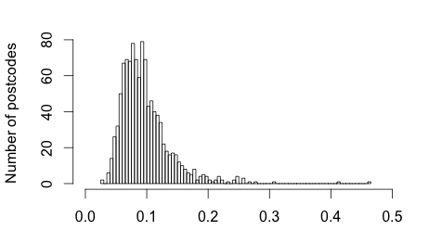
Extension – Data Visualisation
Notes:
nation_wide_rate: 0.08855657
Postcode level summary:
Min. :0.02658
1st Qu.:0.07015
Median :0.08930
Mean :0.09696
3rd Qu.:0.11298
Max. :0.46296
Mention no zero counts. Mention this is a proportion of non-immunised in each post code.

Slide 17
Extension - Models
We consider two models:
Basic iid model
BYM model
SPC model not used.
No zero counts in our data
INLA instead of MCMC for model generation
Less computational expensive
Notes:
We are considering two models.
We considering a very basic iid model, which does not take geo-spatial neighbours into account.
And we consider a BYM model, similar to the model in the original paper.
The reason for including the iid model is to have a benchmark model to see how much the models explanatory power increases when we utilize the neighbors information.
We chose to not include the SPC model as our data do not contain any zero counts. The SPC model is specifically designed for zero-count data by providing a second intercept to model this case. So this would actually be an unnecessarily complex and therefore worse model than the BYM for the immunisation data.
A classical approach to do inference on latent Gaussian models and more specifically compute the posterior marginals is Markov chain Monte Carlo sampling (MCMC).
This procedure is usually very computationally expensive.
A different method to do inference on this type of models is Integrated Nested Laplace Approximation (INLA) which is the method we use here
To be very imprecise the method consist of 3 steps
Approximate posterior marginal of hyperparameters using Laplace approximation
Compute Laplace approximation of the Gaussian parameters conditioned on the hyperparameters and the dependent variable
Combine the 2 using numerical integration
This method is a lot faster and in general produce similar results

Slide 18
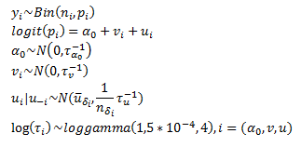
Extension – BYM Model
Notes:
The BYM model in our extension has these specifications, all of which are very similar to the ones used in the paper.
But since our dependent variable is binomial, we are going to use the logit as a link function
And the prior distributions of our precision measures differs from the ones used in the article, since we have chosen the log-gamma as our prior distribution for log(tau)
The difference between our baseline iid model and the BYM model is the v_i term. This is referred to as the Besag component and is the component where we utilize the neighbours information. So the differences between the models are due to this component.

Slide 19
Extension - Results
All of our results on bit.do/VacAustralia
RRF – BYM
RRF – iid
UHExceedence – BYM
UHExceedence - iid
Notes:
The BYM and the iid model both identified the same clusters and were roughly similar, but the BYM model performed better (we will look at this more soon).
Show them some of the links – look around the maps a bit.
All of our results are online on the web for you to look at. We will highlight some major results as follows. We don’t have time to go into all the results.
We also mapped the exceedence probabilities for each of the two models. We don’t have time to talk about this.

Slide 20
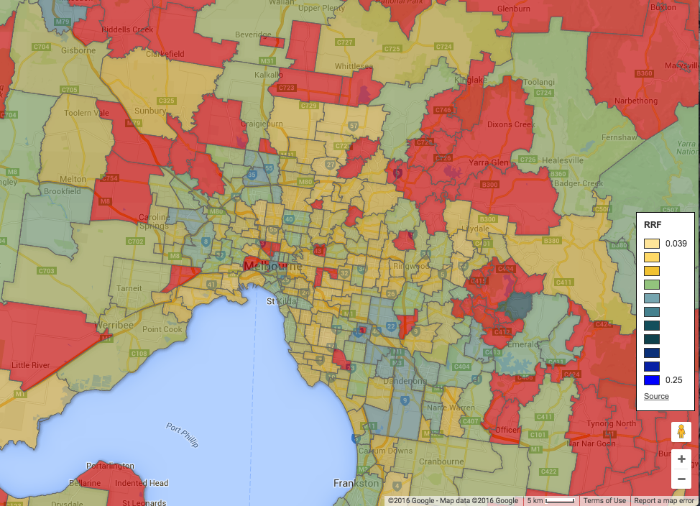
Extension - Results
Notes:
Here is an example of our mapping – this is a map of the relative risk factor for inner Melbourne postcodes. The red areas we don’t have data for. Yellow represents low relative risk – i.e. a high coverage of vaccination. Blue represents high relative risk. You can see there is possibly a cluster around Dandenong, but most of Melbourne has quite good coverage.

Slide 21
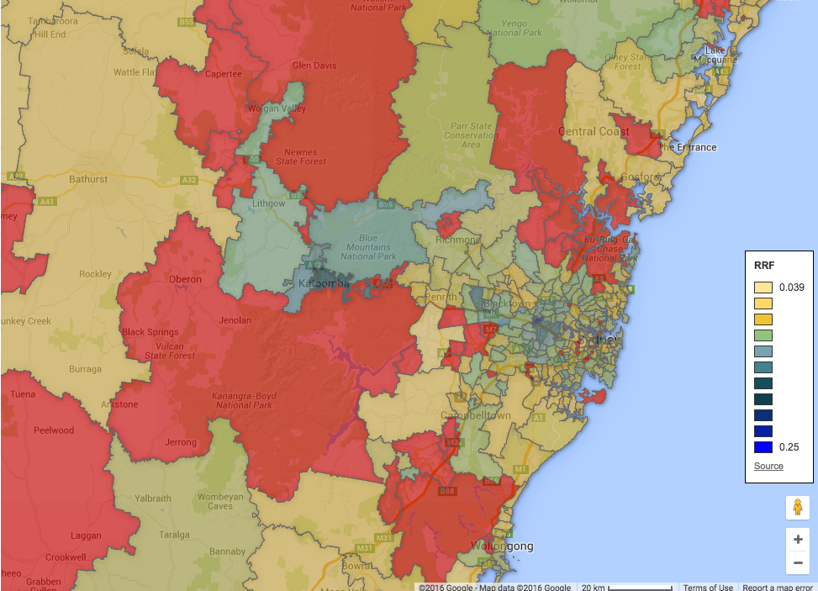
Extension - Results
Notes:
Map of outer Sydney – mapping relative risk factor. Clustering around Katoomba, Parramatta. Hotspot around Blacktown.

Slide 22
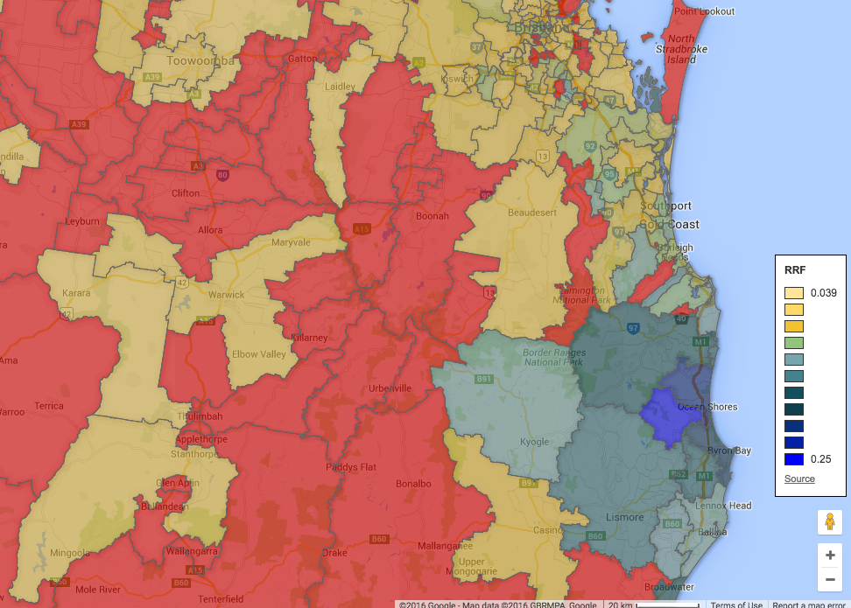
Extension - Results
Notes:
Other major clustering – Byron Bay and Lismore area. Perhaps the most serious cluster in Australia that we have data on. Also another cluster further south around Belligen and Coffs Harbour.

Slide 23
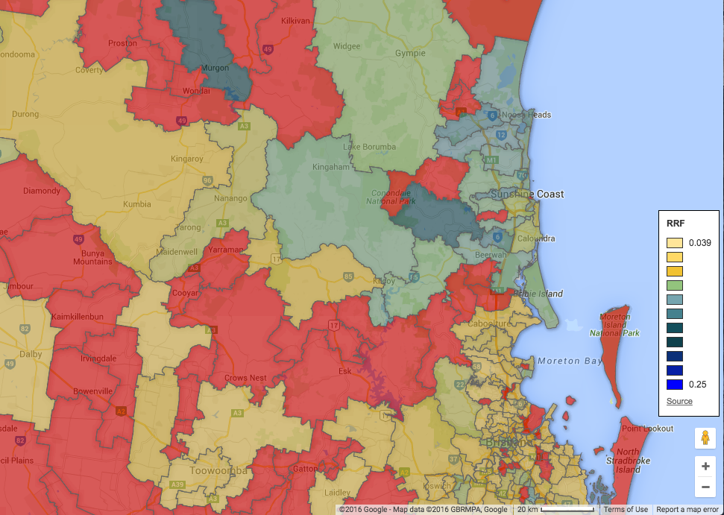
Extension - Results
Notes:
Other major clustering – Sunshine Coast Hinterland

Slide 24
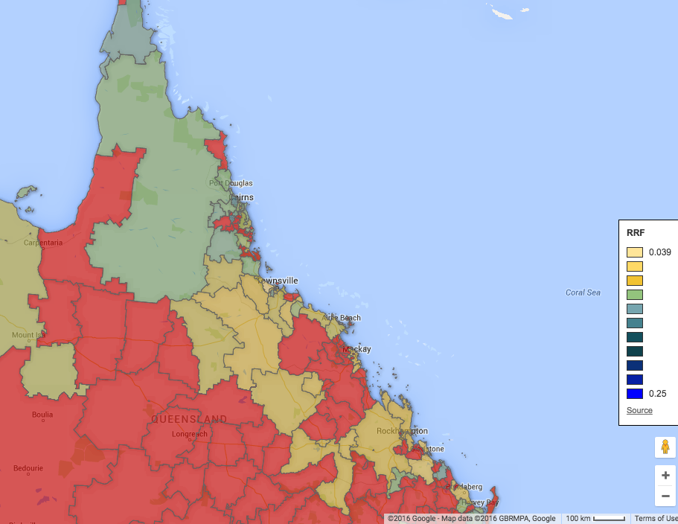
Extension - Results
Notes:
Further north, the immunisation rates decrease with a cluster around Cairns (not obvious on this map, you need to zoom in).

Slide 25
Extension – Comparisons between models
DIC and WAIC
 | BYM | IID
DIC | 6617.9 | 6650.1
WAIC | 6580.1 | 6621.0
Notes:
As we mentioned previously the DIC and WAIC are ‘measure of fit’ estimates to consider the performance of our models. As suspected when considering how similar the results between the two models where the performance is also very similar. The BYM model do have a better fit, but the difference seems small.

Slide 26
Extension - Limitations
Large numbers of postal codes, data not published.
Sparseness
The BYM model would be best for exactly the data that was not published.
Notes:
We generally only had good data on the capital cities and the east coast.
The BYM model is exactly useful in small areas, with low populations – this is where we don’t have data.
Because of unpublished data, there were some sparseness in our maps.
Because of the missing data, the number of neighbours and the cluster effects in general might have been underestimated when we compute the BYM model. This might be one of the reasons we do not win more explanatory power including the Besag part of the model.

Slide 27
References
¹ Andrew B. Lawson & Chawarat Rotejanaprasert, (2014) Childhood Brain Cancer in Florida: A Bayesian Clustering Approach, Statistics and Public Policy 1:1, pages 99-107.
² Andrew B. Lawson, (2014) Hierarchical modeling in spatial epidemiology, WIREs Computational Statistics, 6, pages 405–417.
³ Fine P Mulholland & K., (2013) Ch 71: Community Immunity, In: Plotkin S, Orenstein W, Offit P (editors). Vaccines. 6th ed. China: Elsevier Saunders.
⁴ Robert I. Menzies et. al., (2012) Controlling measles in NSW: how are we doing in the context of other countries in the Western Pacific?, NSW Public Health Bulletin, 23:9-10, pages 169-170.

Slide 28
References cont.
⁵ National Health Performance Authority, (2015) Healthy Communities: Immunisation rates for children in 2014–15, online at http://www.myhealthycommunities.gov.au/our-reports/immunisation-rates-for-children/february-2016, accessed 29th April 2016.
⁶ Australian Bureau of Statistics, (2011) Postal Areas ASGS Non ABS Structures Ed 2011 Digital Boundaries in ESRI Shapefile Format, online at http://www.abs.gov.au/AUSSTATS/abs@.nsf/DetailsPage/1270.0.55.003July%202011?OpenDocument, accessed 29th April 2016.

Slide 29
Questions?
Thank you!

